Slide 1
Product Sales Analysis
Insights and Recommendations for Optimizing Sales Strategy
Sakir Tirsi
September 2024
Notes:
Introduce yourself and the purpose of the presentation.
Briefly outline that the focus is on analyzing sales methods to optimize strategy.

Slide 2
Project Overview
Objective
Provide insights into how different sales methods contribute to revenue and suggest improvements for optimizing sales efforts.
Business Goals
Understand sales performance across methods (Email, Call, Email + Call).
Identify areas for growth and resource allocation.
Focus on high-performing regions and methods.
Notes:
Explain that the project’s objective was to analyze the company’s sales data to provide actionable insights.
Outline the main business goals:
Understanding how different sales methods perform.
Identifying areas for growth.
Optimizing resource allocation.

Slide 3
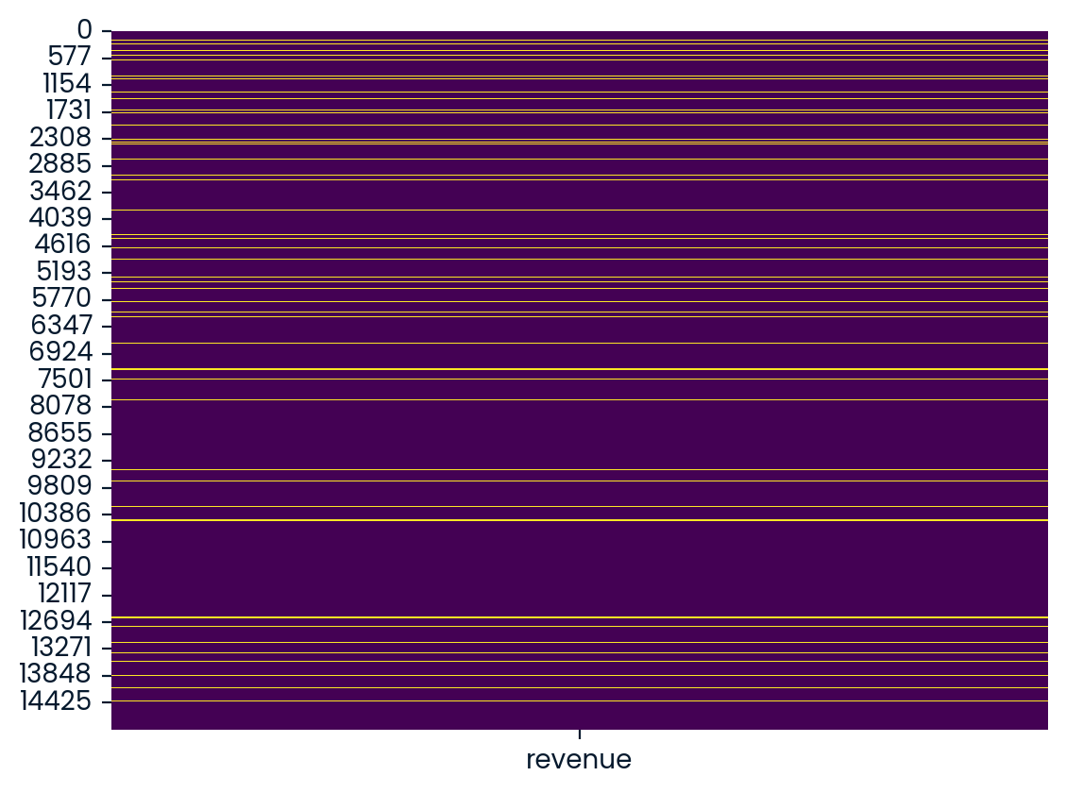
Data Validation
Actions Taken:
Corrected inconsistencies in sales methods.
Handled missing revenue data by imputing based on average sales.
Adjusted customer age to correct outliers.
Verified state data and other columns.
Notes:
Mention that before diving into the analysis, we ensured the dataset was clean and accurate.
Highlight key actions:
Fixed inconsistencies in sales method naming.
Imputed missing revenue values based on average sales per product sold.
Adjusted customer age data to remove outliers (reset values over 40 to 40).
No major issues found with customer IDs or state names.
Briefly explain the heatmap showing missing values in the revenue column.

Slide 4
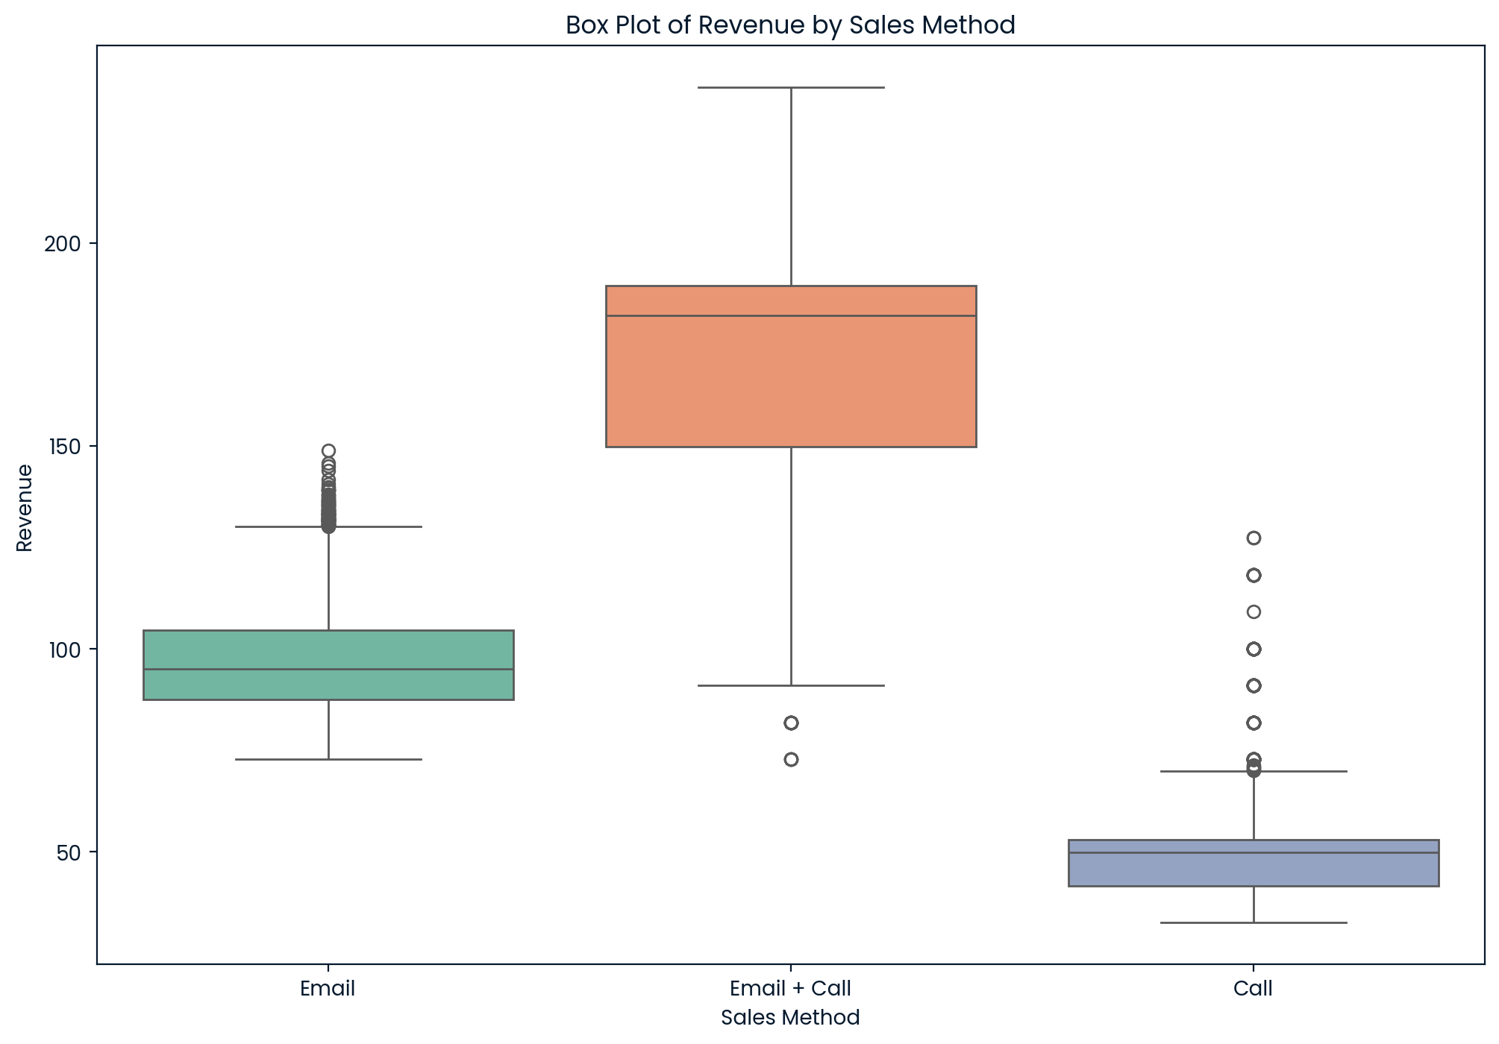
Analysis Overview
Methods Analyzed:
Email
Call
Email + Call
Key Metrics Evaluated
Total and average revenue
Sales distribution by state, method and customer tenure
Notes:
Mention the three main sales methods we focused on: Email, Call, and Email + Call.
Explain that we evaluated key metrics like total revenue, average revenue, and spread of sales by state and years as a customer.
Point to the graph showing the distribution of revenue across the sales methods to highlight the differences in performance.

Slide 5
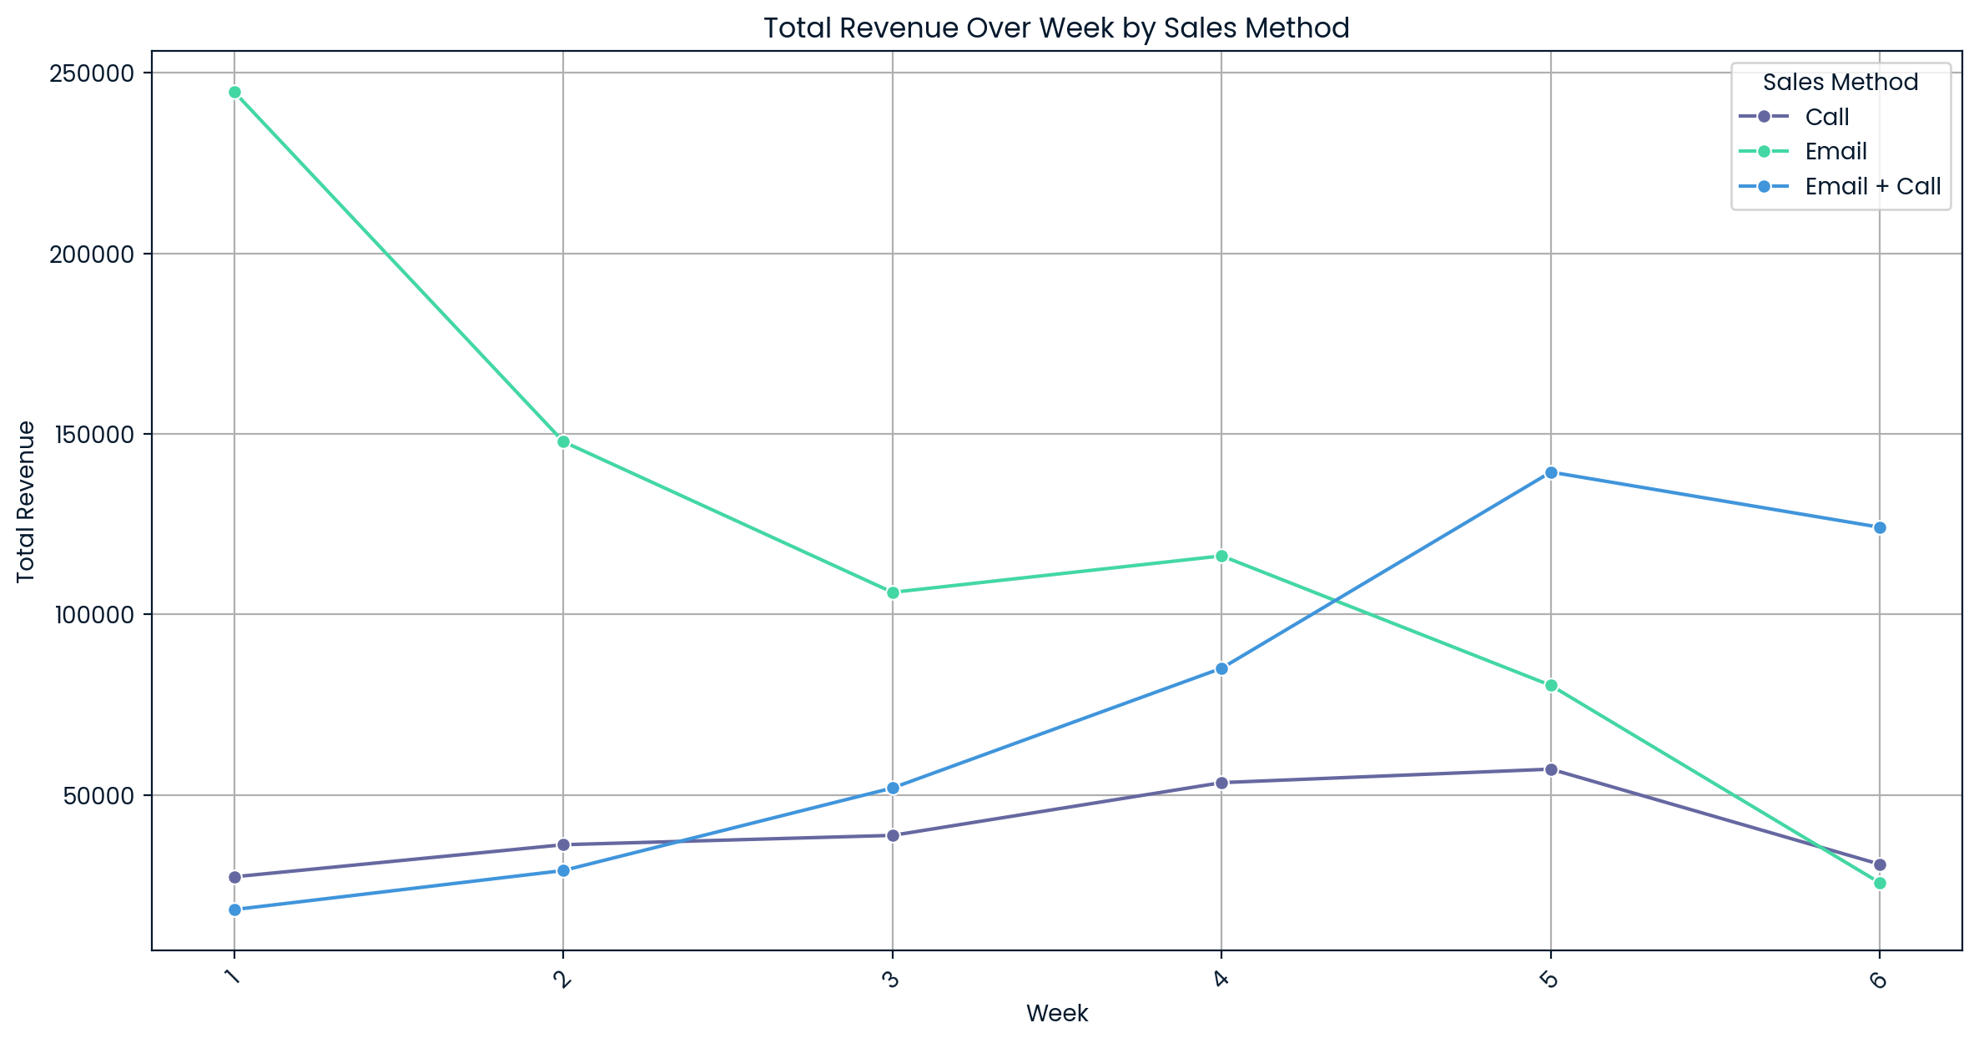
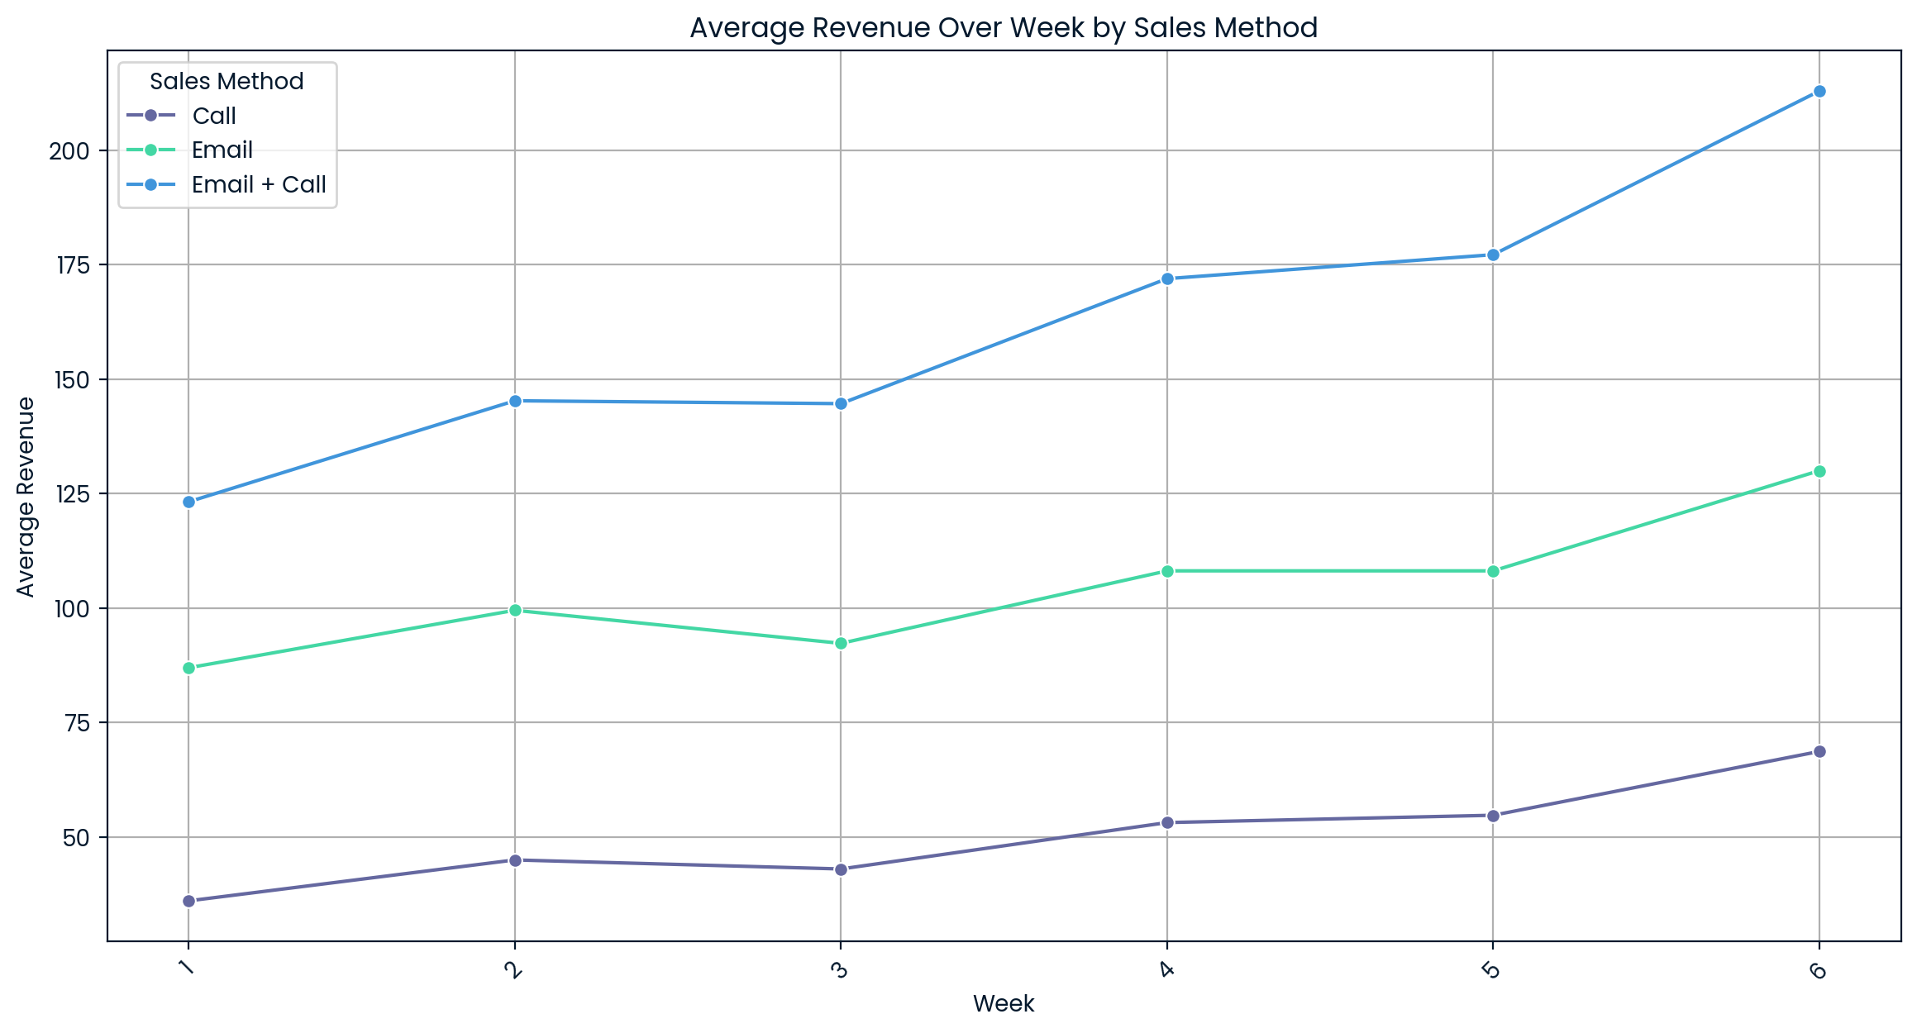
Key Findings
Email Method: Strong early performance, declining after week 4.
Email + Call: Initially slow, but surpasses other methods in the later weeks.
Call Method: Consistently low performance, except in high-performing states.
Notes:
Summarize key insights:
Email method: Strongest in the first few weeks, but revenue declines after week 4.
Email + Call method: Shows strong growth in later weeks, surpassing other methods after week 4.
Call method: Consistently the lowest performer, except in a few high-performing states.
Explain the graph showing total and average revenue by sales method, pointing out that Email + Call performs best in the long run.

Slide 6
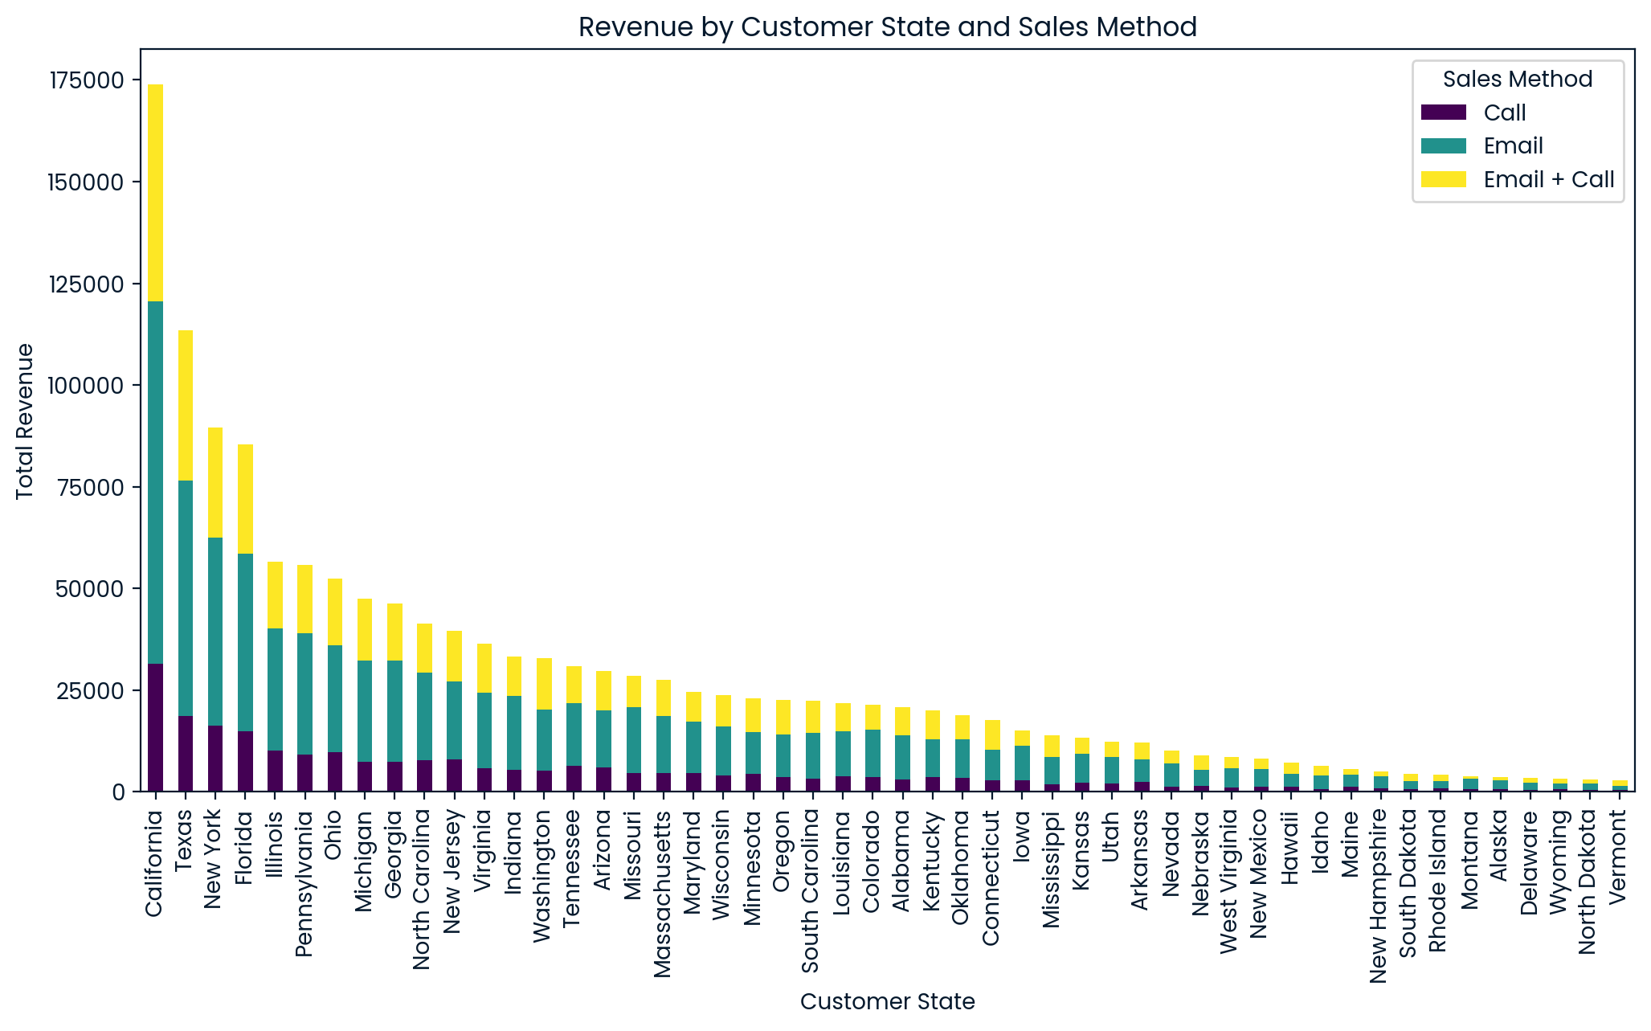
Revenue by State
Key States:
California, Texas, New York, Florida lead in revenue.
Call method in California generates more revenue than many states’ total revenue.
Notes:
Highlight the most significant states for revenue: California, Texas, New York, and Florida.
Emphasize that California, in particular, generates very high revenue, especially through the Call method, which outperforms many other states’ total revenue.
Point to the graph showing state-by-state revenue and how the sales methods differ across states.

Slide 7
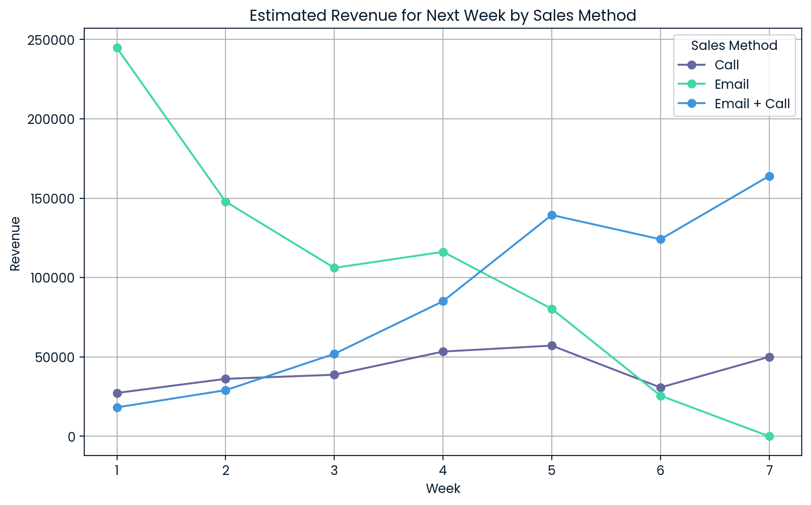
Metric to Monitor
Suggested Metric
Weekly total revenue by sales method
This helps track which method is driving revenue growth and when to adjust strategy
Estimation:
Email + Call method show growth potential
Call method underperforms.
Notes:
Introduce the key metric to monitor: Weekly total revenue by sales method.
This will help the business keep track of which method is driving revenue growth over time.
Show how past trends indicate that the Email + Call method is gaining momentum, while Call and Email are either stagnant or declining.
Walk through the prediction graph showing future estimates for each method if current trends continue.

Slide 8
Recommendations
Focus on Email + Call:
Scale this method for sustained growth.
Optimize Call Efforts:
Either reduce or refine this labor-intensive method, focusing on high-performing states.
State-Specific Strategies:
Prioritize sales efforts in CA, TX, NY, and FL.
Monitor & Experiment:
Continue tracking sales methods and experiment with strategies in underperforming states.
Notes:
Focus on Email + Call: Since it shows the best long-term potential, invest more resources here to drive revenue growth.
Optimize Call Efforts: The Call method is labor-intensive and underperforms. Either reduce the resources here or focus it on states where it’s performing well (e.g., California).
State-Specific Strategies: Prioritize efforts in high-revenue states like California, Texas, New York, and Florida.
Monitor & Experiment: Continue to monitor weekly revenue and experiment with improving underperforming methods (e.g., Call in lower-revenue states).

Slide 9
Conclusion
Summary
Email + Call has long-term growth potential.
Target states driving the highest revenue.
Refine strategies for low-performing methods like Call.
Notes:
Summarize the key points again:
The Email + Call method offers the most promise for future growth.
Target high-revenue states and optimize strategies for each region.
Refine or reduce efforts for underperforming sales methods like the Call approach.
Offer a final recommendation to start implementing these changes and continue monitoring the key metrics.

